Slide 1
Semiconductor Diodes

Slide 2
Semiconductors in Summary
• The most popular material is silicon.
• Pure crystals are intrinsic semiconductors.
• Doped crystals are extrinsic semiconductors.
• Crystals are doped to be n type or p type.
• A doped semiconductor will have mostly
majority carriers and a few thermally generated minority carriers.
Electrons are majority carriers in n type.
Holes are majority carriers in p type

Slide 3
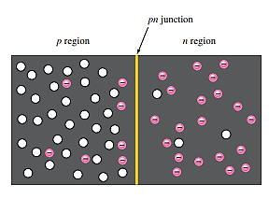
PN-Junction and Depletion Region
When a p-type materials are combined with n-type materials, a pn junction forms and a semiconductor diode is created.
When p and n type material is combined:
The n region loses a free electron as they diffuse across the junction and combines with a hole.
A positive charge is left in the n region and a negative charge is created in the p region, forming a barrier potential.
This region of uncovered positive and negative ions is called the depletion region due to the “depletion” of free carriers in the region.

Slide 4
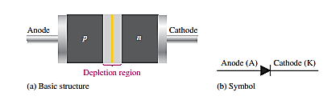
The diode
A diode can be made by a silicon or a germanium semiconductor material.
For a diode half is doped as a p region and another half is doped as an n region.
In a pn junction a depletion region exist in between p and n type materials.
A
K

Slide 5
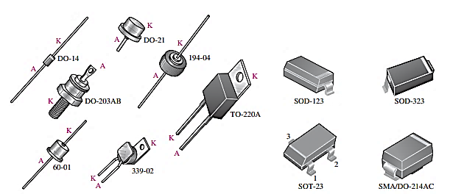
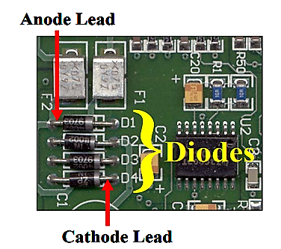
The diode
(a) Through-hole mounted packages
(b) Surface-mounted diode packages

Slide 6
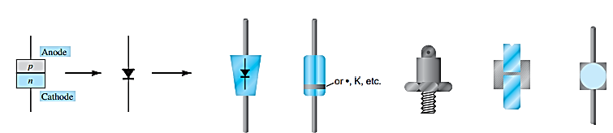
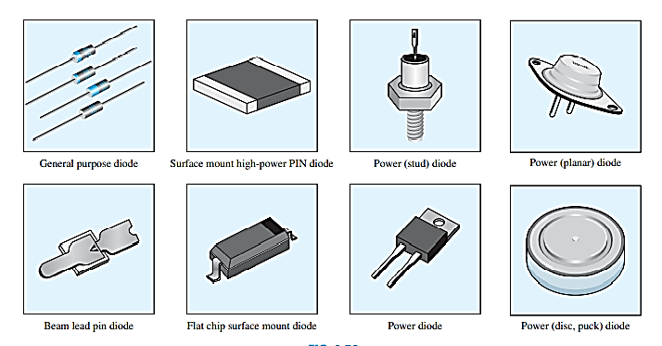
Semiconductor Diode Notation

Slide 7
Diode Operating Condition
A diode has three operating conditions:
No bias
Reverse bias
Forward bias

Slide 8
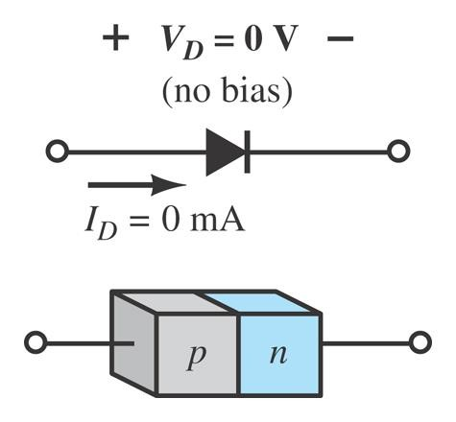
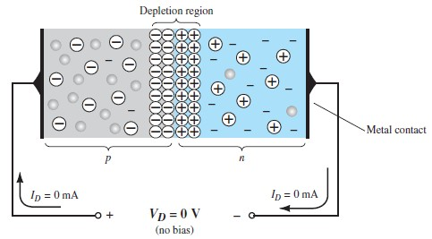
Diode Operating Conditions
No Bias:
No external voltage is applied: V_{D} = 0 V There is no diode current: I_{D} = 0 A
Only a modest depletion region exists.

Slide 9
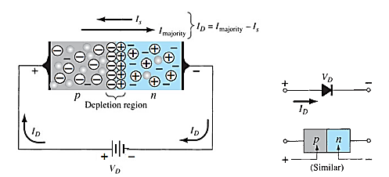
Forward Bias (V_{d}>0)
A forward-bias or “on” condition is established by applying the positive potential to the p -type material and the negative potential to the n -type material.
V_{bias} must be greater than ‘barrier potential’.

Slide 10
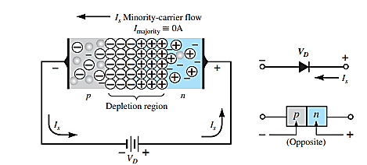
Reverse Bias (V_{d}<0)
The positive terminal of an external potential of V volts is applied to the n -type material and the negative terminal is connected to the p -type material.
Reverse bias is a condition that prevents current through junction.
Depletion region get wider with this configuration,

Slide 11
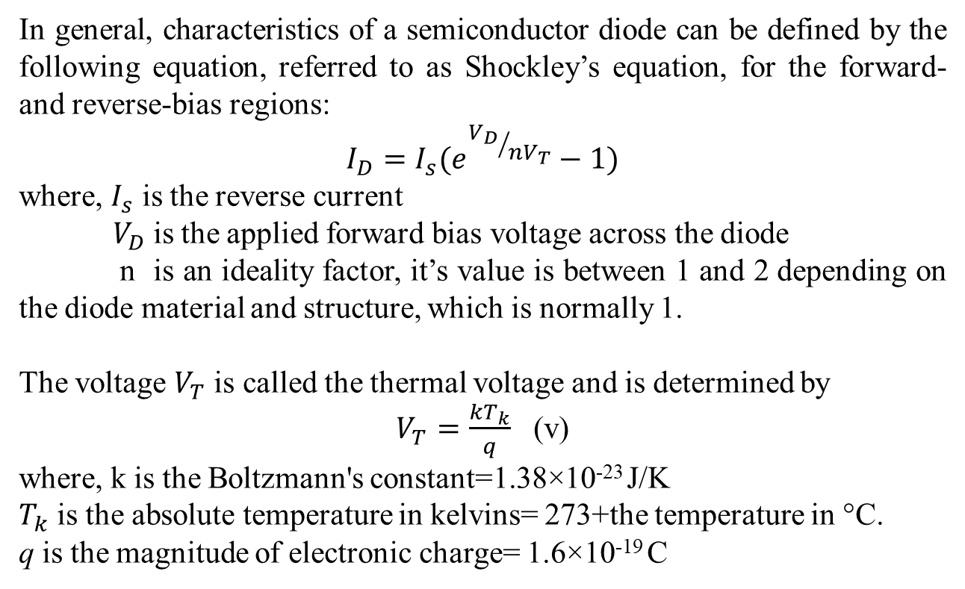
Diode Equation
In general, characteristics of a semiconductor diode can be defined by the following equation, referred to as Shockley’s equation, for the forward- and reverse-bias regions:
$$I_{D}=I_{s}(e^{{V_{D}}/{nV_{T}}}−1)$$
where, $I_{s}$ is the reverse current
$V_{D}$is the applied forward bias voltage across the diode
n is an ideality factor, it’s value is between 1 and 2 depending on the diode material and structure, which is normally 1.
The voltage $V_{T}$ is called the thermal voltage and is determined by
$V_{T}=\frac{kT_{k}}{q}$ (v)
where, k is the Boltzmann's constant=1.38×10⁻²³ J/K
$T_{k}$ is the absolute temperature in kelvins= 273+the temperature in °C.
q is the magnitude of electronic charge= 1.6×10⁻¹⁹ C

Slide 12
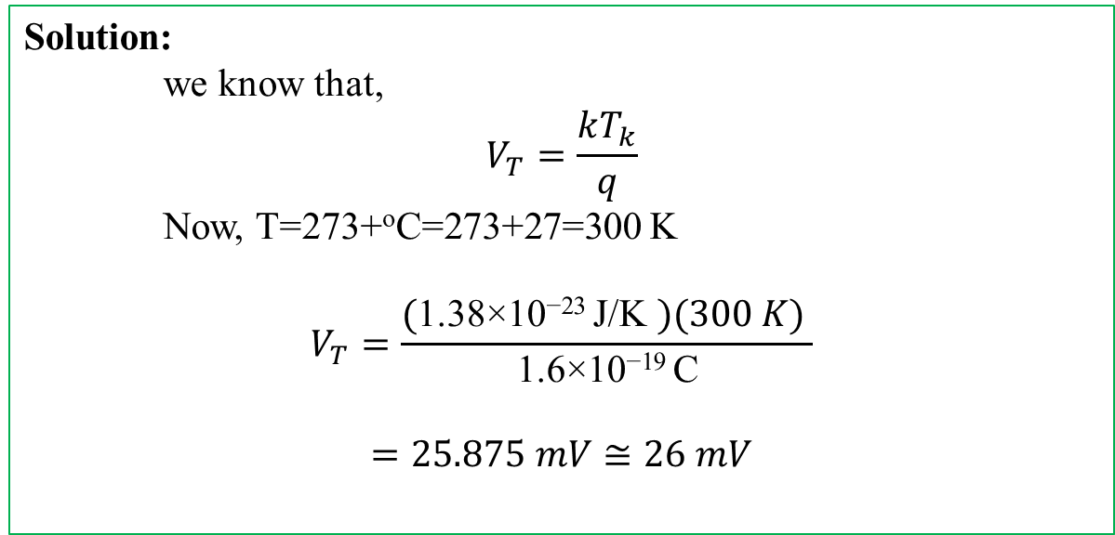
Diode Equation
Problem: At a temperature of 27°C (common temperature for components in an enclosed operating system), determine the thermal voltage V_{T}.
Solution:
we know that,
$$V_{T}=\frac{kT_{k}}{q}$$
Now, T=273+ºC=273+27=300 K
$$V_{T}=\frac{\text{(}\text{1.38×10}\text{−23 }\text{J}\text{/}\text{K} )(300 K) }{\text{1.6×10}\text{−19 }\text{C}}$$
$$=25.875 mV≅26 mV$$

Slide 13
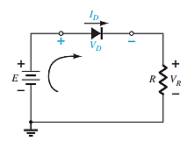
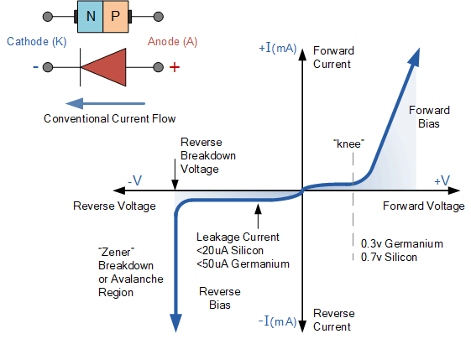
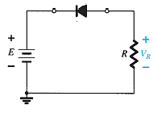
I-V Characteristics
I_{D}(mA)
-V_{D}
V_{D}
-I_{D}(mA)

Slide 14
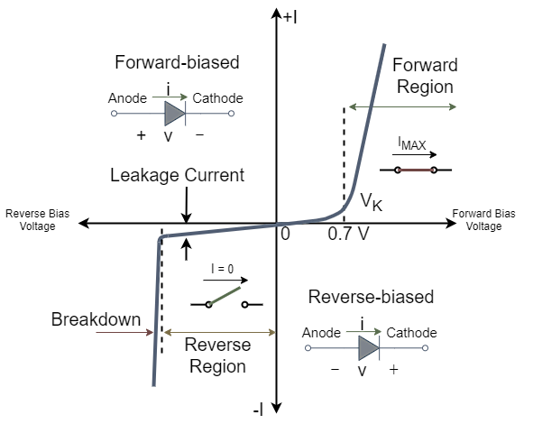
Knee Voltage
The minimum amount of voltage required for conducting the diode is known as “knee voltage” or “threshold voltage” or “ cut in voltage”.
The forward voltage at which the current through pn-junction starts increasing rapidly is known as knee voltage.
Knee voltage of germanium diode is 0.3 volts.
Knee voltage of silicon diode is 0.7 volts.

Slide 15
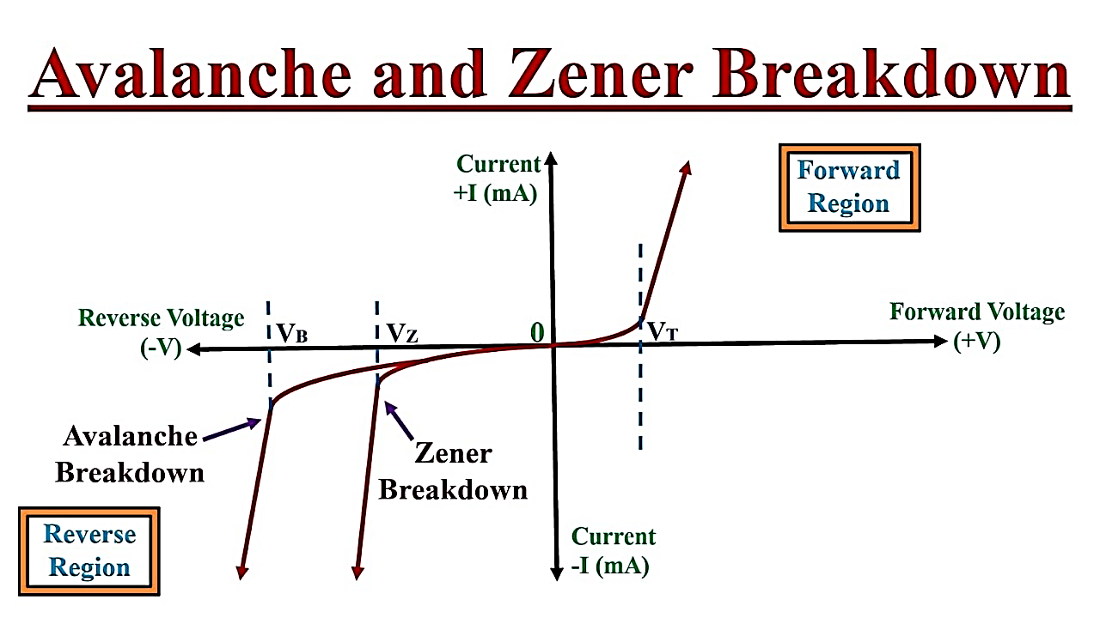
Breakdown Region
The breakdown region is in the diode’s reverse-bias region.
At some point the reverse bias voltage is so large (at breakdown voltage V_{BV}) the diode breaks down and the reverse current increases dramatically.
This can be destructive if the power
dissipated exceeds the "safe" level
The maximum reverse voltage that won’t take a diode into the zener region is called the peak inverse voltage or peak reverse voltage.
Two mechanisms:
Zener breakdown: Due to high electric field at the depletion region (up to
about 5V)
Avalanche breakdown: The avalanche breakdown occurs because of the collision of free electrons with atoms (Due to high kinetic energy of electrons) (5V and above)

Slide 16
Resistance Levels
Semiconductors react differently to DC and AC currents.
There are three types of resistance:
DC (static) resistance AC (dynamic) resistance Average AC resistance

Slide 17
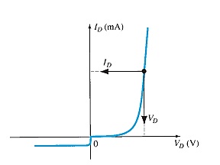
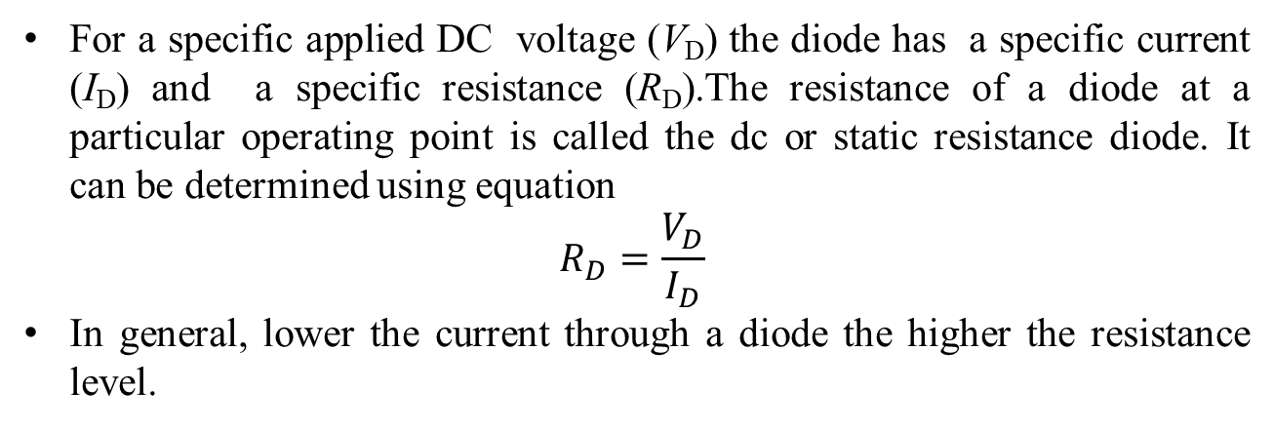
DC or Static Resistance
For a specific applied DC voltage (V_{D}) the diode has a specific current (I_{D}) and a specific resistance (R_{D}).The resistance of a diode at a particular operating point is called the dc or static resistance diode. It can be determined using equation
$$R_{D}=\frac{V_{D}}{I_{D}}$$
In general, lower the current through a diode the higher the resistance level.

Slide 18
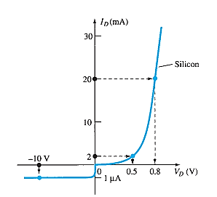
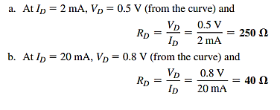

Resistance Levels
Example: Determine the dc resistance levels for the diode of the following figure at
I_{D} 2 mA (low level)
I_{D} 20 mA (high level)
V_{D} 10 V (reverse-biased)

Slide 19
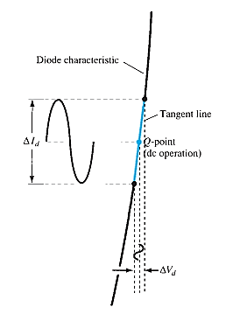
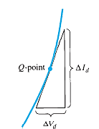
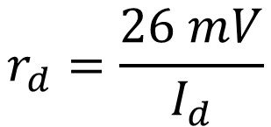
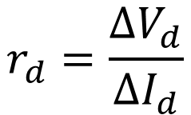
AC or Dynamic Resistance
Static resistance is using dc input. If the input is sinusoidal the scenario will be changed.
The varying input will move instantaneous operating point UP and DOWN of a region.
Thus specific changes in current and voltage is obtained. It can be determined using equation
$$r_{d}=\frac{∆V_{d}}{∆I_{d}}$$
$$r_{d}=\frac{26 mV}{I_{d}}$$
In the forward bias region:
The resistance r_{d} depends on the amount of current (I_{D}) in the diode.

Slide 20

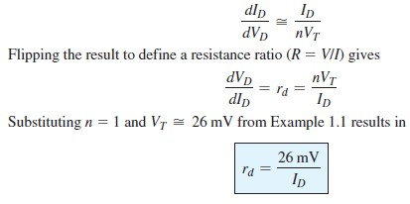
Analytical Derivation of r_{d}

Slide 21
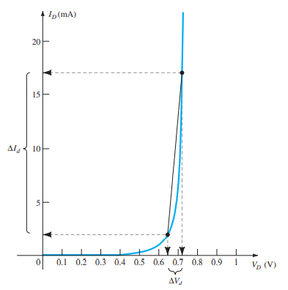

Average AC Resistance
If the input signal is sufficiently large to produce a broad swing, the resistance associated with the device for this region is called the average ac resistance.
It can be determined by a straight line drawn between the two intersection established by the maximum and minimum values of input voltage.

Slide 22
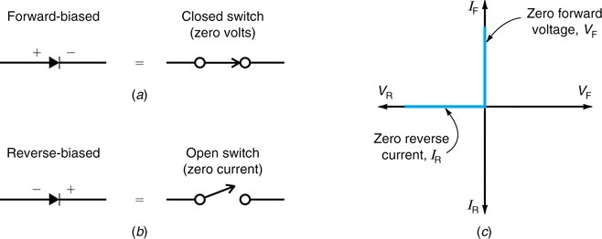
Equivalent Circuit model of a diode
Three different approximations can be used when analyzing diode circuits
Ideal equivalent circuit
Simplified equivalent circuit
Piecewise-linear equivalent circuit
Ideal equivalent circuit: It treats a forward-biased diode like a closed switch with a voltage drop of zero volts, as shown below.

Slide 23
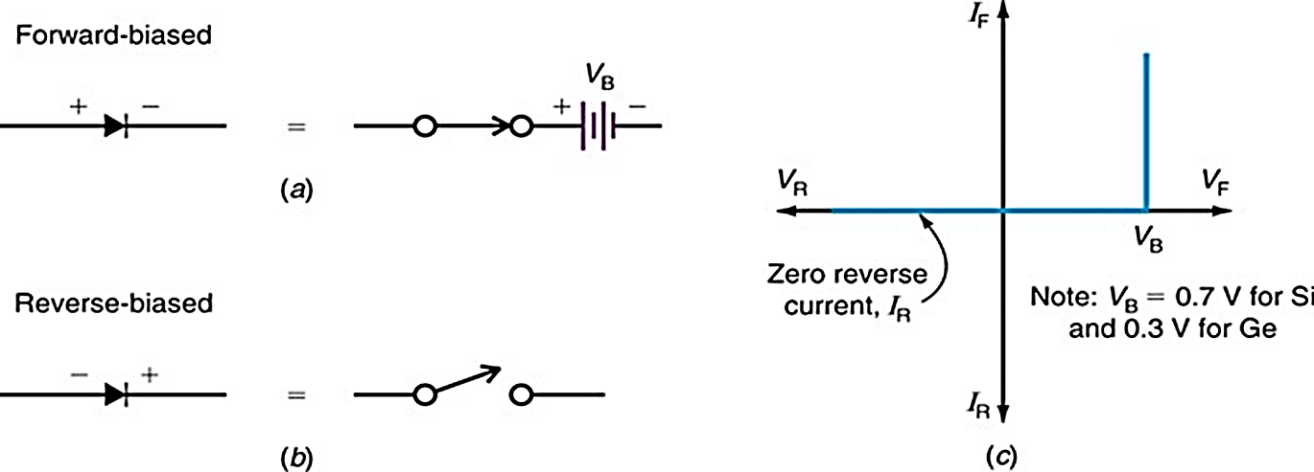
Equivalent Circuit model of a diode
Simplified equivalent circuit: The second approximation treats a forward-biased diode like an ideal diode in series with a battery, as shown below
=0.7 V for Si

Slide 24
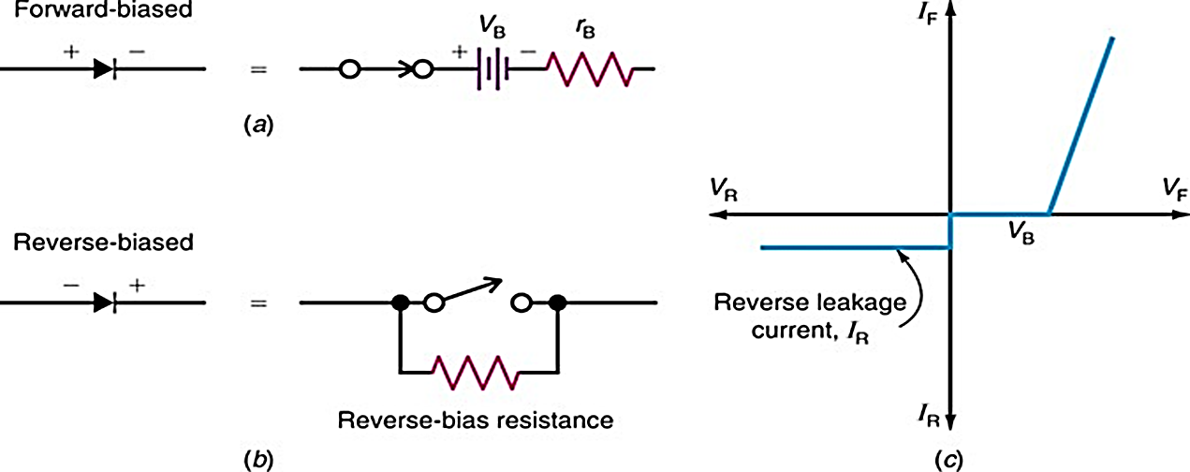
Equivalent Circuit model of a diode
Piece-wise equivalent circuit: It treats a forward-biased diode like a closed switch with a voltage drop of zero volts, as shown below.
The third approximation of a diode includes the bulk resistance, r_{B}.
The bulk resistance, r_{B} is the resistance of the p and n materials.
The third approximation of a forward-biased diode is shown below

Slide 25
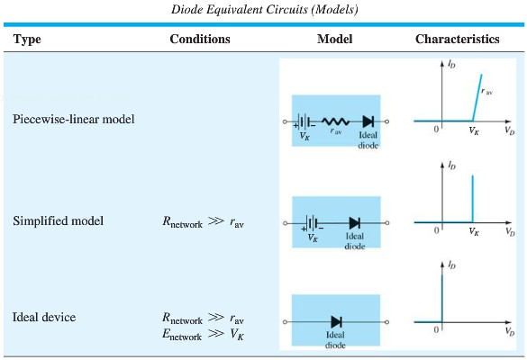
Summary Table
3rd Approximation
2nd Approximation
1st Approximation

Slide 26
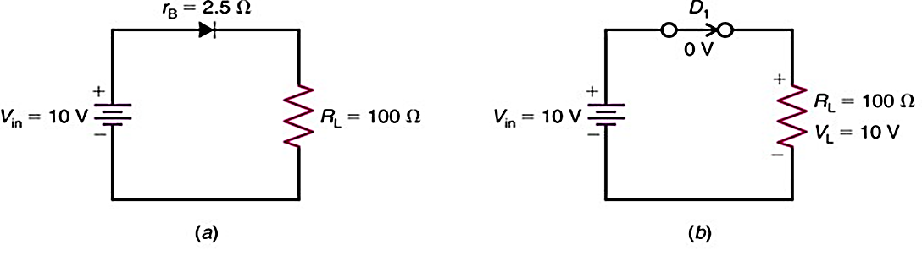
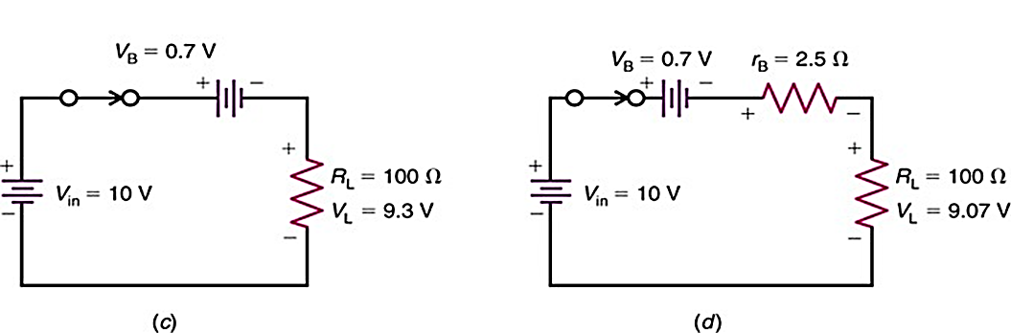
Circuit Models for the Semiconductor Diode
First approximation
Second approximation
Third approximation

Slide 27
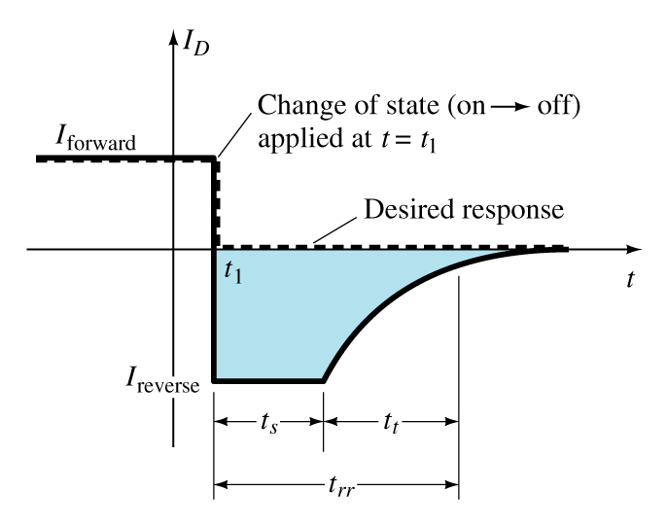
Reverse Recovery Time (t_{rr})
Reverse recovery time is the time required for a diode to stop conducting when switched from forward bias to reverse bias.

Slide 28
Diode Specification Sheets
Diode data sheets contain standard information, making cross-matching of diodes for replacement or design easier.
Forward Voltage (V_{F}) at a specified current and temperature
Maximum forward current (I_{F}) at a specified temperature
Reverse saturation current (I_{R}) at a specified voltage and temperature
Reverse voltage rating, PIV or PRV or V_{(BR)}, at a specified temperature
Maximum power dissipation at a specified temperature
Capacitance levels
Reverse recovery time, t_{rr}
Operating temperature range

Slide 29
Other Types of Diodes
There are several types of diodes besides the standard
p-n junction diode. Three of the more common are:
Zener diodes
Light-emitting diodes

Slide 30
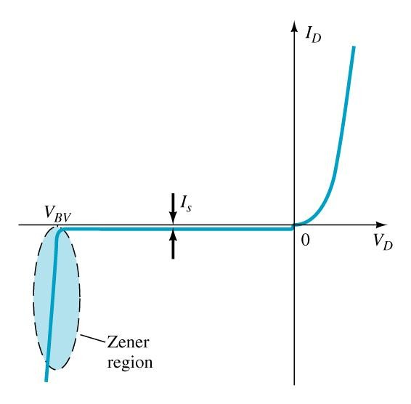
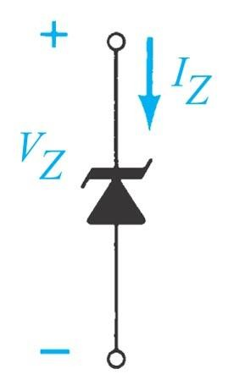
Zener Diode
A Zener diode is one that is designed to safely operate in its zener region; i.e., biased at the Zener voltage (V_{Z}).
=V_{z}
Common zener diode voltage ratings are between 1.8 V and 200 V

Slide 31
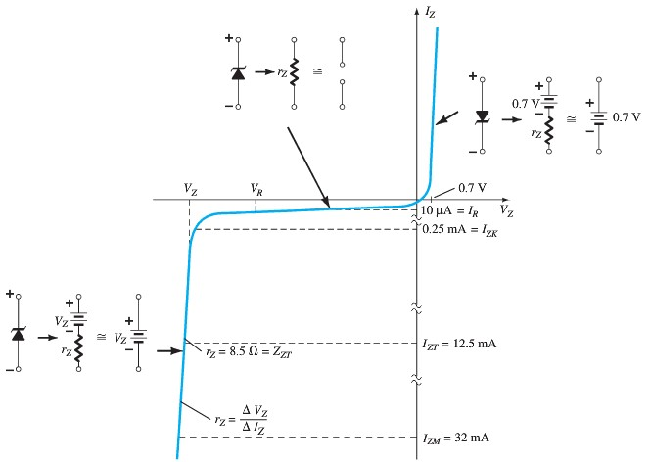
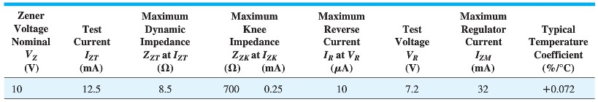
Zener Diode Characteristics
Typical specifications for a 10-V, 500-mW, 20% Zener diode
Expected to vary as 10 V + 20%, or from 8 V to 12 V.
Both 10% and 50% diodes are also readily available.

Slide 32
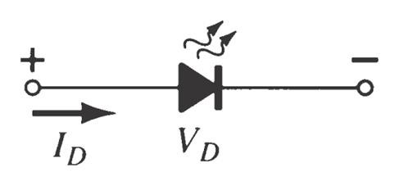
Light-Emitting Diode (LED)
An LED emits light when it is forward biased, which can be in the infrared or visible spectrum.
The forward bias voltage is usually in the range of 1.5 V to 2.5 V.

Slide 33
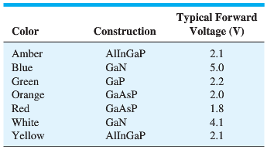
Light-Emitting Diodes

Slide 34
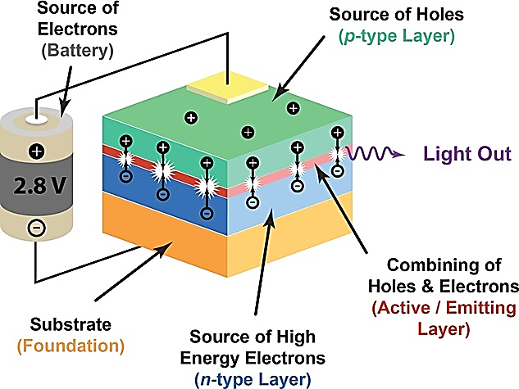
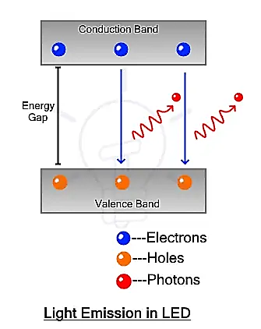
Causes of Light in LEDs
In a forward-biased LED, free electrons cross the junction and fall into holes
As these electrons fall from a higher to a lower energy level, they radiate energy
In an LED, the energy is radiated as light
The color of the light depends on the bandgap of the diode material

